Slide 1

Through these beautiful pictures books, the children will explore the concepts of equality, diversity, acceptance of differences and of the right of someone to have an opinion different to their own through a range of high quality picture books

Slide 2
EYFS
No Outsiders picture books
Helping to prepare children to live in a modern world

Slide 3
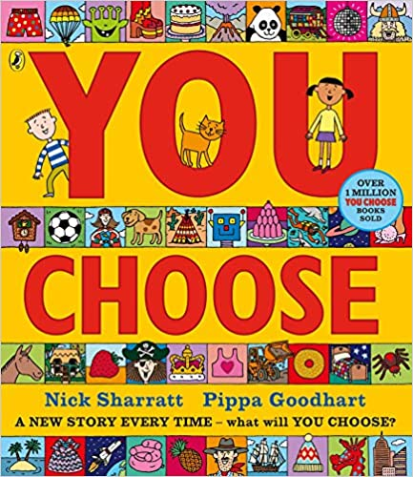
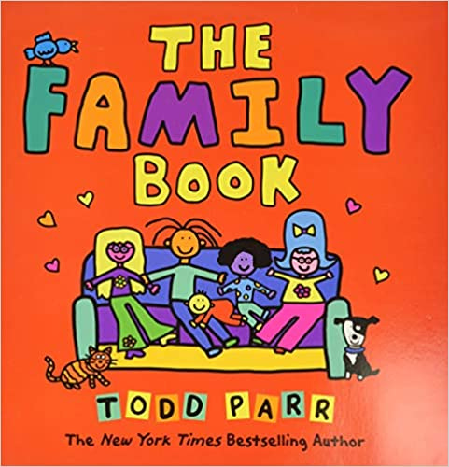
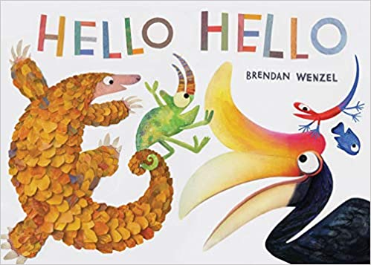
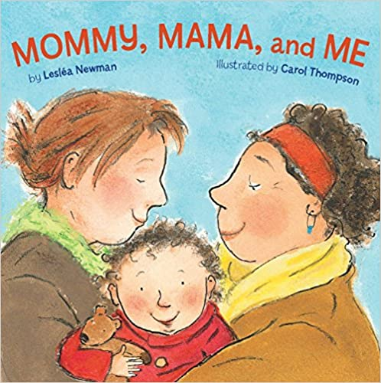



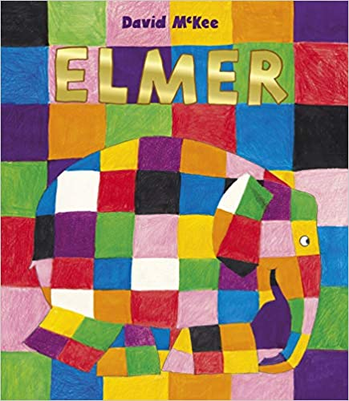
You Choose by Nick Sharratt and Pippa Goodheart
I can choose what I like
I can make up my own mind and tell you thinks I like
I can ask others what they think
The Family Book by Todd Parr
All families are different
I know who my family is
I know all families are different
Hello Hello by Bendan Wenzel
To say hello
I know in my class we are not all the same
I know we are different
I know I can make friends with different people
I know how to make friends
Mommy, mama and Me by Leslea Newman and Carol Thompson
To celebrate my family
I know people in my family are special
I can tell you who loves you
Going to the Volcano by Andy Stanton
To join in
I know we are all different
I know we can play together
I can join in
Blue Chameleon by Emily Gravett
To make new friends
I know everyone is different in my class
I can make friends with anyone
Elmer by David Mckee
I like the way I am
I know we are all different
I know how to make my class welcoming
Red Rocks and the Rainbow by Sue Heap and Nick Sharratt
It’s ok to like different things I know my friends can like different thingsI know we can still be friends

Slide 4
Year 1
No Outsiders picture books
Helping to prepare children to live in a modern world

Slide 5
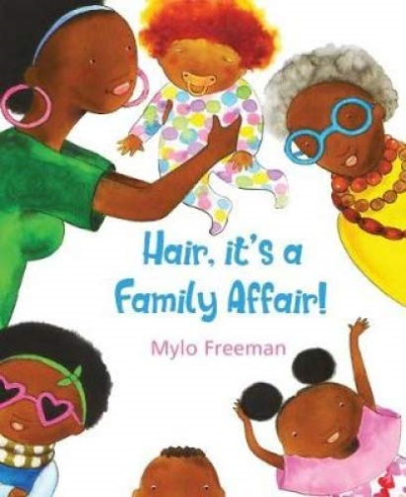

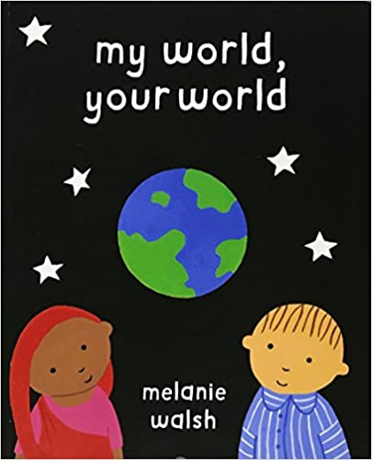
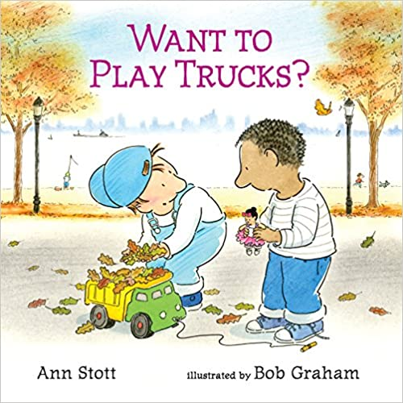

Elmer by David McKee
I recognise the ways in which I am the same and different to others
I recognise that we are all unique and what makes me special
I can recognise different feelings and understand how they affect our bodies and how we behave
Hair, It’s a Family Affair by Mylo Freeman
I recognise the ways in which I am the same and different to others
I recognise that we are all unique and what makes me special
Going to the Volcano by Andy Stanton
I understand that bodies and feelings can be hurt by words and actions
I understand what is kind and unkind behaviour, and how this can affect others
I recognise that we are all unique and what makes me special
My World, Your World by Melanie Walsh
I recognise that we are all unique and what makes me special
I recognise the ways in which I am the same and different to others
Want to Play Trucks? By Ann Stott and Bob Graham
I know how people make friends and what makes a good friendship
I understand that people have different feelings to each other at different times
I recognise the ways in which I am the same and different to others
Errol’s Garden by Gillian Hibbs
I can identify people who love and care for me and the role they have in my life
I know how I can help look after their environment

Slide 6
Year 2
No Outsiders picture books
Helping to prepare children to live in a modern world

Slide 7
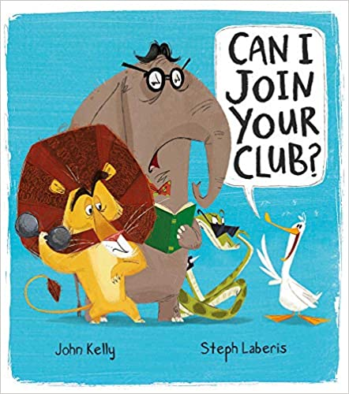
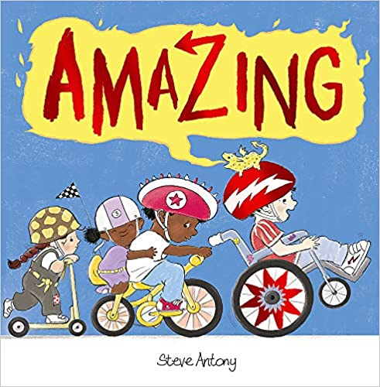
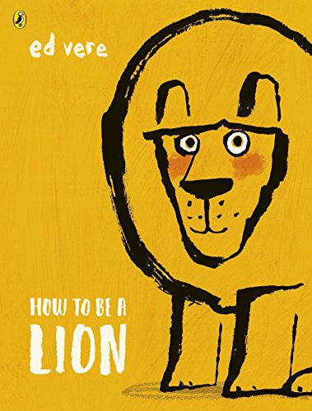
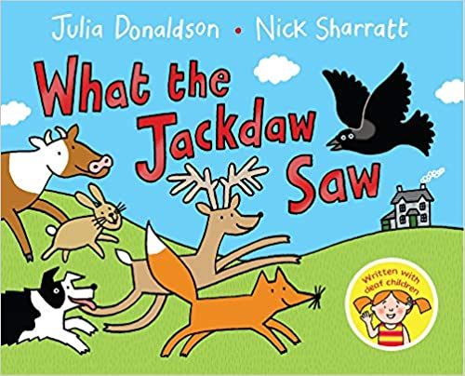
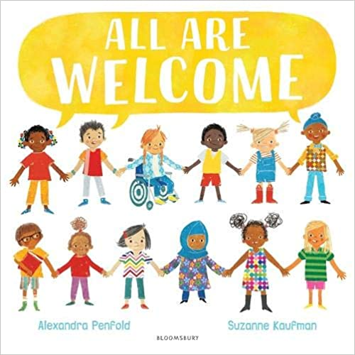
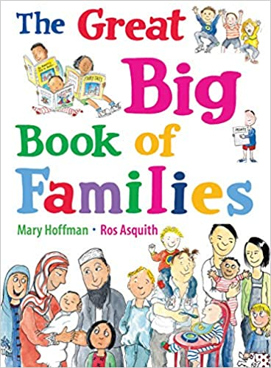
Can I Join Your Club? By John Kelly and Steph Laberis
I can identify how I am the same as, and different to, other people
I can use simple strategies to resolve arguments between friends positively
Amazing by Steve Antony
I can treat myself and others with respect
I can use simple strategies to resolve arguments between friends positively
I understand how people and other living things have different needs
I understand the responsibilities of caring for others
How to be a Lion by Ed Vere
I can treat myself and others with respect
I can use simple strategies to resolve arguments between friends positively
I can identify how I am the same as, and different to, other people
What the Jackdaw Saw by Julia Donaldson and Nick Sharratt
I understand how people and other living things have different needs
The Great Big Book of Families by Mary Hoffman and Ros Asquith
I can identify common features of family life
I understand how people and other living things have different needs
I know there are different types of families and that they might be different to mine
I can identify how I am the same as, and different to, other people
All Are Welcome by Alexandra Penfold and Suzanne Kaufman
I can treat myself and others with respect
I can identify how I am the same as, and different to, other people

Slide 8
Year 3
No Outsiders picture books
Helping to prepare children to live in a modern world

Slide 9
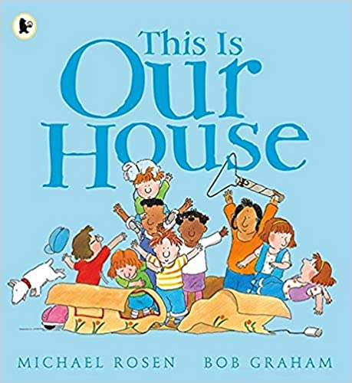
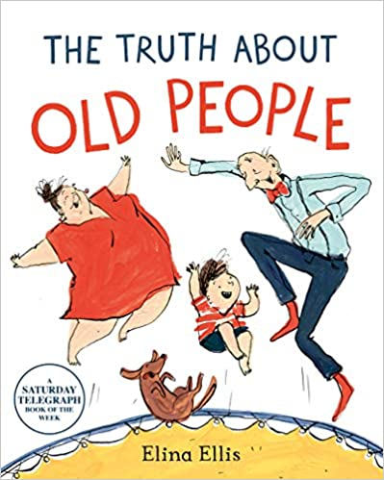
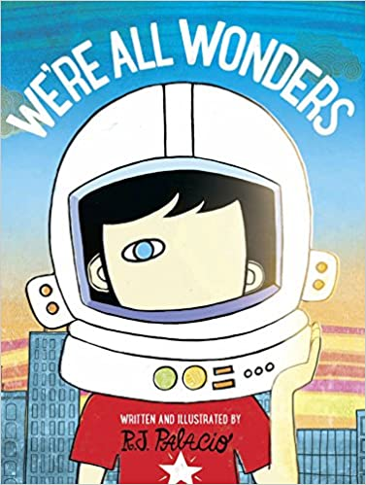



This Is Our House by Michael Rosen
I can identify and value different groups that make up my community and what living in a community means
I know the impact of bullying, including offline and online, and the consequences of hurtful behaviour
I understand that my behaviour can affect other people
The Truth About Old People by Elina Ellis
I can identify and value different groups that make up my community and what living in a community means
I understand that my behaviour can affect other people
We’re All Wonders by RJ Palacio
I can use strategies for building positive friendships
I understand that my behaviour can affect other people
I can identify and value different groups that make up my community and what living in a community means
The Hueys in the New Jumper by Oliver Jeffers
I know ways to support positive mental health (talking about feelings, sleep, exercise, outdoors, hobbies, being with people)
I can use strategies for building positive friendships
I know what constitutes a positive healthy friendship -online or face-to-face
I understand that my behaviour can affect other people
I can identify and value different groups that make up my community and what living in a community means
Beegu by Alexis Deacon
I can use strategies for building positive friendships
I know what constitutes a positive healthy friendship
I understand that my behaviour can affect other people
Planet Omar: Accidental Trouble Magnet by Zanib Mian
I can identify and value different groups that make up my community and what living in a community means

Slide 10
Year 4
No Outsiders picture books
Helping to prepare children to live in a modern world

Slide 11
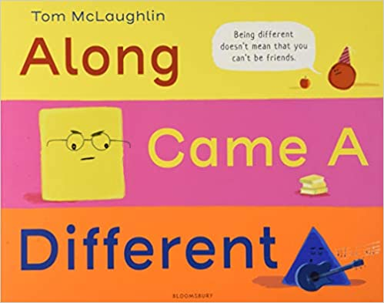

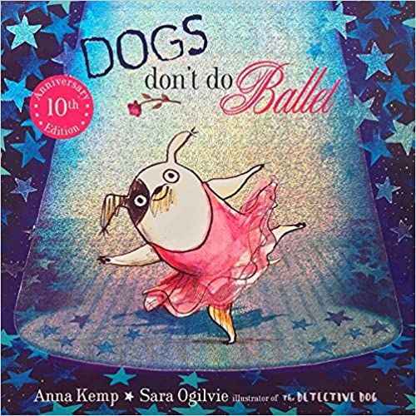
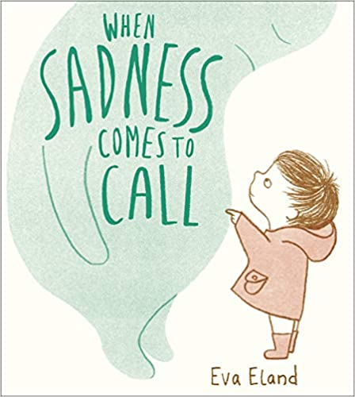

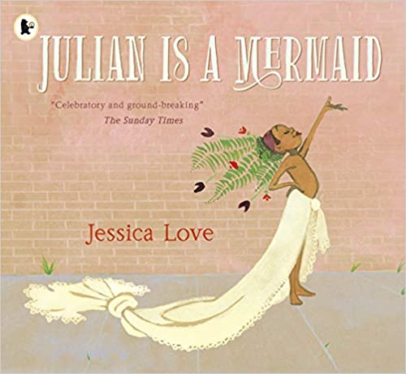
Along Came a Different by Tom McLaughlin
I understand and value diversity and the benefits of living in a diverse community
I can celebrate my personal identity (gender, faith, family, ethnicity, likes/dislikes, character)
Aalfred and Aalbert by Morag Hood
I recognise shared characteristics of healthy family life, including care, commitment, time together; support
I understand and value diversity and the benefits of living in a diverse community
Dogs Don’t Do Ballet by Anna Kemp and Sarah Ogilvie
I recognise the positive impact of self-respect
I understand and value diversity and the benefits of living in a diverse community
I can celebrate my personal identity (gender, faith, family, ethnicity, likes/dislikes, character)
I know how to form respectful relationships (inc online and in wider society)
I can use strategies to respond to feelings, including intense and conflicting feelings, in an appropriate and proportionate way
When Sadness Comes to Call by Eva Eland
I understand how regular exercise benefits physical and mental health
I understand that feelings can vary in intensity and can use a varied vocabulary to describe them
I can use strategies to respond to feelings, including intense and conflicting feelings, in an appropriate and proportionate way
Julian is a Mermaid by Jessica Love
I recognise the positive impact of self-respect
I understand and value diversity and the benefits of living in a diverse community
Red: A Crayon’s Story by Michael Hall
I recognise the positive impact of
self-respect
I can celebrate my personal identity (gender, faith, family, ethnicity, likes/dislikes, character)

Slide 12
Year 5
No Outsiders picture books
Helping to prepare children to live in a modern world

Slide 13

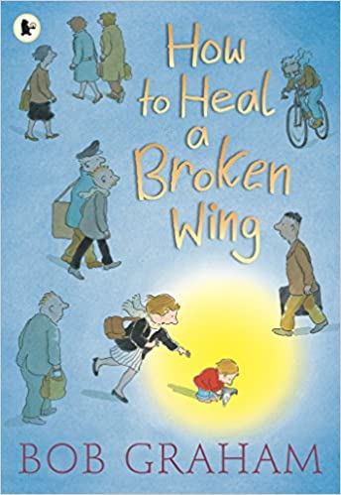
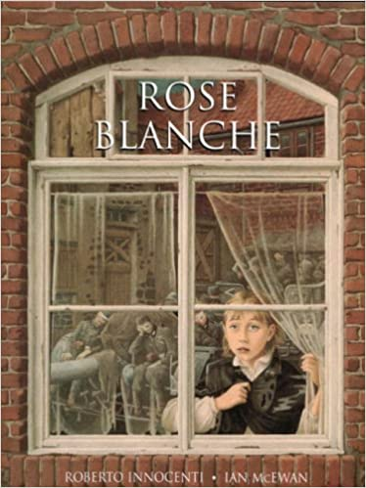
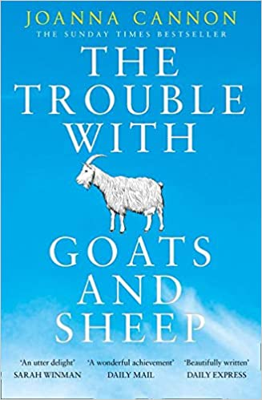
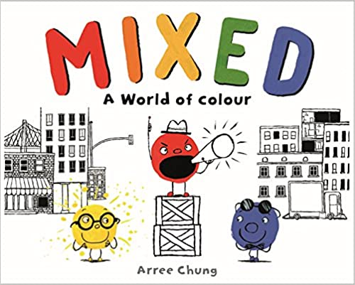
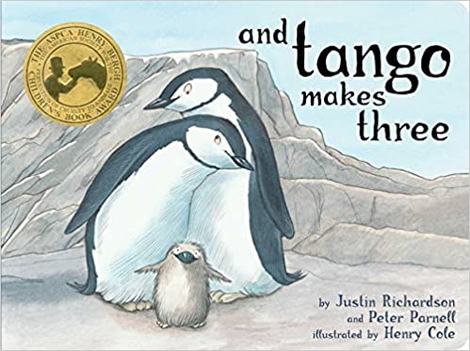
How to Heal a Broken Wing by Bob Graham
I know how to display my responsibilities we all have for caring for other people and living things
I understand the importance of having compassion
I respect the differences (beliefs, families, etc) and similarities between people and focus on recognising what I have in common with others
Kenny Lives with Erica and Martina by Olly Pike
I know how to display my responsibilities we all have for caring for other people and living things
I understand the importance of having compassion
Rose Blanche by Ian McEwan and Roberto Innocenti
I know strategies for recognising and managing peer influence/approval inc effect of online actions
I know what to do when under pressure from others to do something unsafe or that makes me feel uncomfortable
I know how to display my responsibilities we all have for caring for other people and living things
I understand the importance of having compassion
The Girls by Lauren Lee and Jenny Lovlie
I know friendships can change over time and the benefits of having different/new types of friends
I understand the importance of having compassion
Mixed by Arree Chung
I understand what discrimination is and how to challenge it
I understand what stereotypes are, their negative impact and how to challenge them
I understand the importance of having compassion
I respect the differences (beliefs, families, etc) and similarities between people and focus on recognising what I have in common with others
And Tango Makes Three by Justin Richardson and Peter Parnell
I respect the differences (beliefs, families, etc) and similarities between people and focus on recognising what I have in common with others
I respect that there are different types of family structure (including foster, same-sex and step-parents, blended families) and all types can give family members love, security and stability

Slide 14
Year 6
No Outsiders picture books
Helping to prepare children to live in a modern world

Slide 15
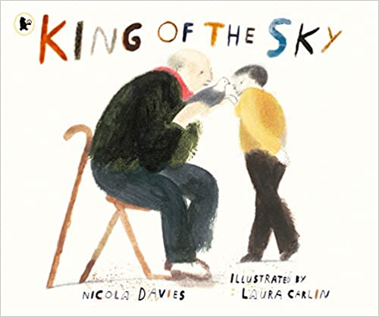

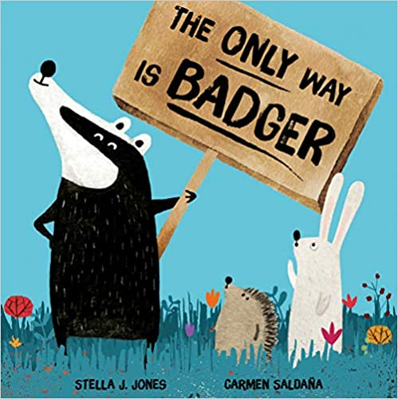
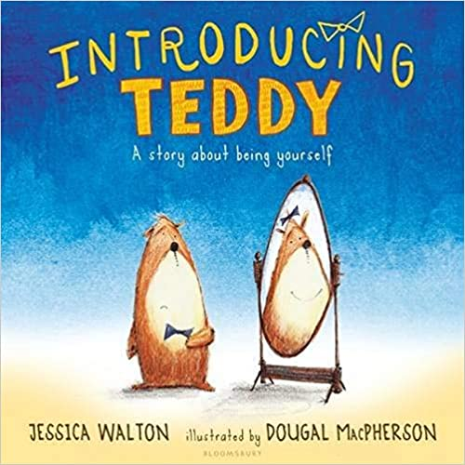
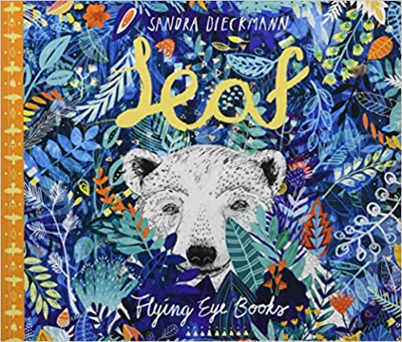
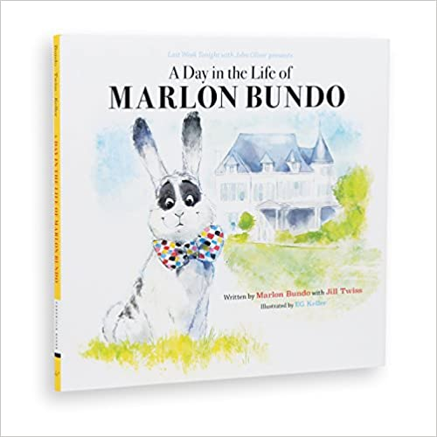
King of the Sky by Nicola Davis
I understand what prejudice is and how to recognise and react to behaviours/actions which discriminate against others
The Island by Armin Greder
I understand what prejudice is and how to recognise and react to behaviours/actions which discriminate against others
The Only Way is Badger by Stella J. Jones and Carmen Saldana
I can discuss and debate topical issues whilst respecting other people’s point of view and constructively challenge those I disagree with
I understand what prejudice is and how to recognise and react to behaviours/actions which discriminate against others
Introducing Teddy by Jessica Walton and Dougal MacPherson
I know that gender identity and sexual orientation are different
A Day in the Life of Marlon Bundo by Marlon Bundo and Jill Twiss
I can discuss and debate topical issues whilst respecting other people’s point of view and constructively challenge those I disagree with
I know ways of carrying out shared responsibilities for protecting the environment in school and at home and how everyday choices can affect the environment
I understand that new opportunities and responsibilities will arise as I gain independence
Leaf by Sandra Dieckmann
I can use problem-solving strategies to deal with emotions, challenges and changes such as transition to high school
I understand what prejudice is and how to recognise and react to behaviours/actions which discriminate against others

