Slide 1
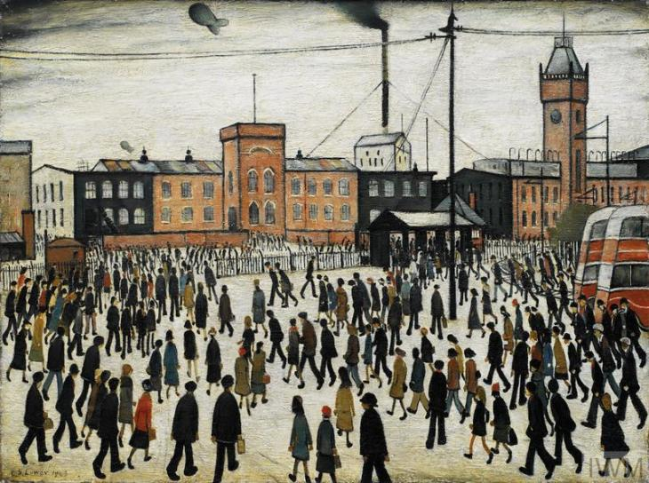
Art
LS Lowry is our artist which we are studying this half term. We have looked at the different shading techniques he used.
Can you create a one page fact file about him.
Where did he come from?
What were his favourite things to sketch?
What were key dates in his life?
What are the names of his most famous pieces of art?
Where would you go if you wanted to see some of his art?
Present this how you wish – think about adding pictures, fact boxes and maps. You could even have a go at recreating one of his pieces of art.
You must include 10 facts.
We will share some of these facts in our next art lesson.

