Slide 1
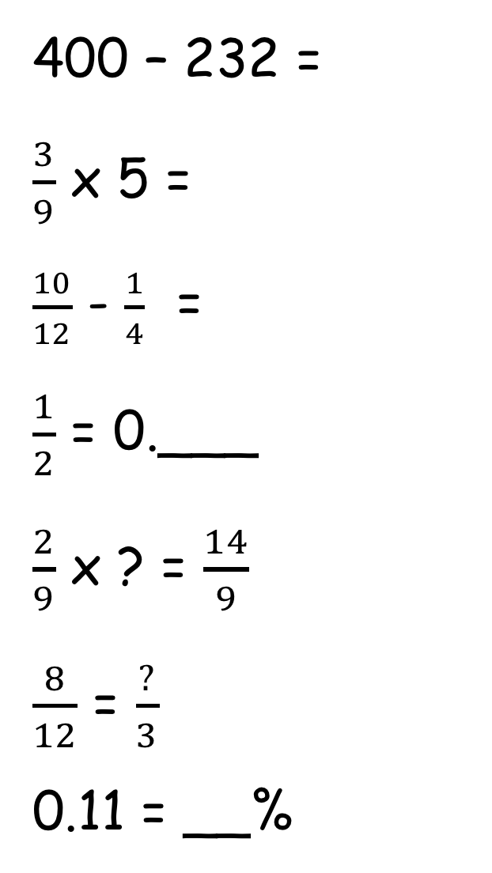
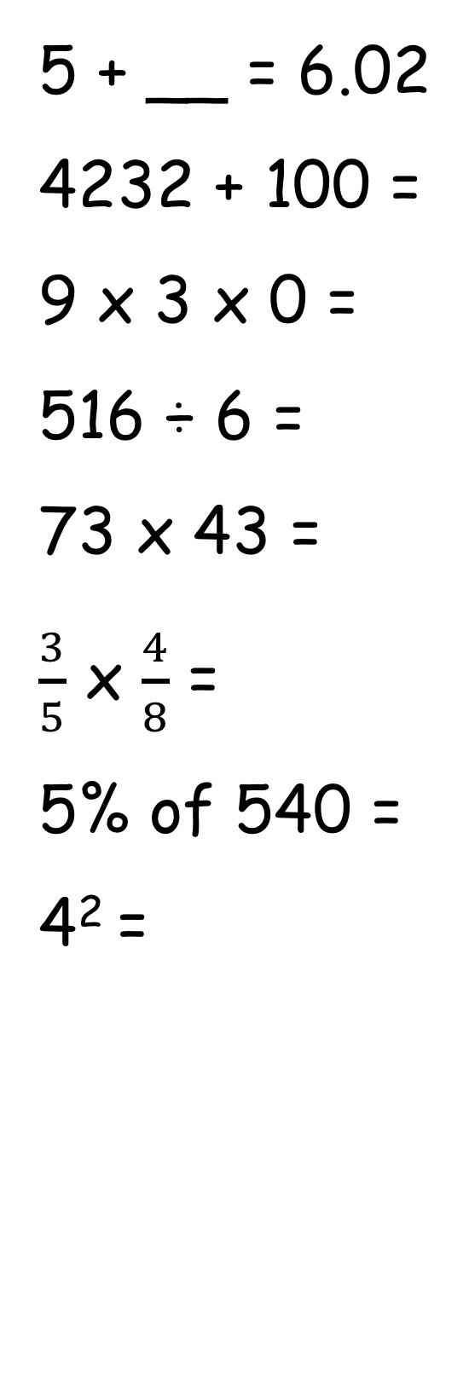
5 + __ = 6.02
4232 + 100 =
9 x 3 x 0 =
516 ÷ 6 =
73 x 43 =
$\frac{3}{5}$ x $\frac{4}{8}$ =
5% of 540 =
4² =
400 – 232 =
$\frac{3}{9}$ x 5 =
$\frac{10}{12}$ - $\frac{1}{4}$ =
$\frac{1}{2}$ = 0.___
$\frac{2}{9}$ x ? = $\frac{14}{9}$
$\frac{8}{12}$ = $\frac{?}{3}$
0.11 = __%
3
10 minute arithmetic
99 x 10 =
43 ÷ 10 =
1365 ÷ 15 =
9 x 7 + 7 =
3168 ÷ 9 =
87 x 32 =
672ml = ___litres
8.8cm = ___mm

Slide 2
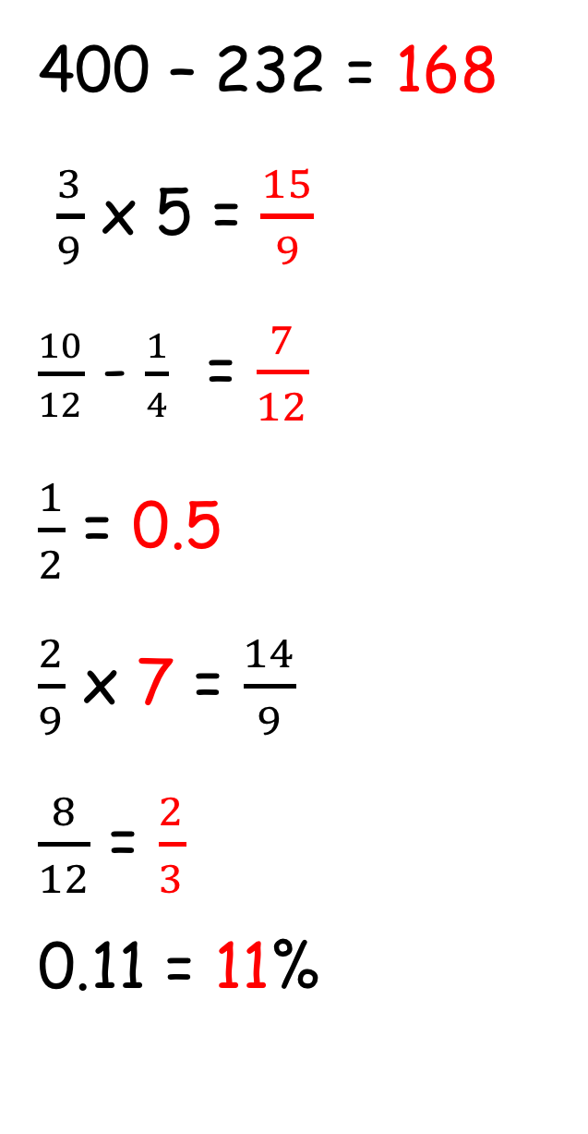
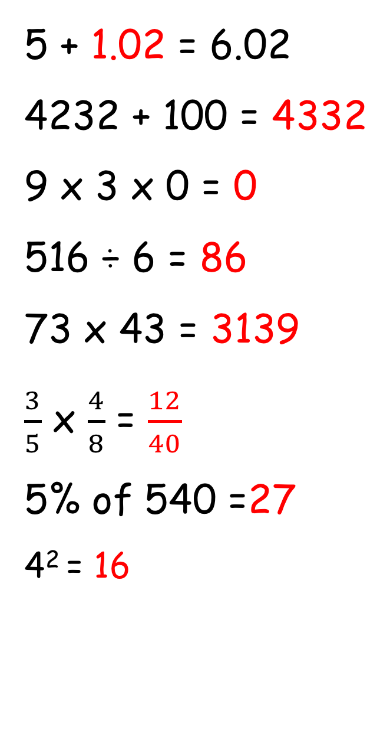
5 + 1.02 = 6.02
4232 + 100 = 4332
9 x 3 x 0 = 0
516 ÷ 6 = 86
73 x 43 = 3139
$\frac{3}{5}$ x $\frac{4}{8}$ = $\frac{12}{40}$
5% of 540 =27
4² = 16
10 minute arithmetic
400 – 232 = 168
$\frac{3}{9}$ x 5 = $\frac{15}{9}$
$\frac{10}{12}$ - $\frac{1}{4}$ = $\frac{7}{12}$
$\frac{1}{2}$ = 0.5
$\frac{2}{9}$ x 7 = $\frac{14}{9}$
$\frac{8}{12}$ = $\frac{2}{3}$
0.11 = 11%
99 x 10 = 990
43 ÷ 10 = 4.3
1365 ÷ 15 =91
9 x 7 + 7 = 70
3168 ÷ 9 = 352
87 x 32 = 2784
672ml = 0.672 litres
8.8cm = 88mm

Slide 3

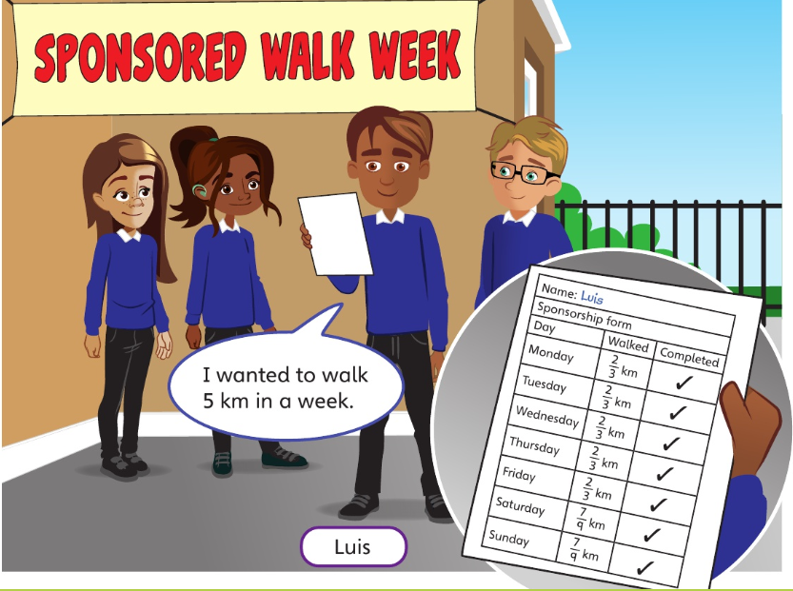
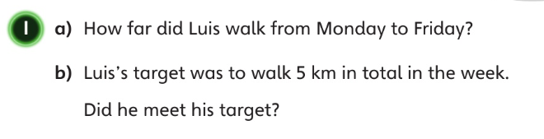

Slide 4
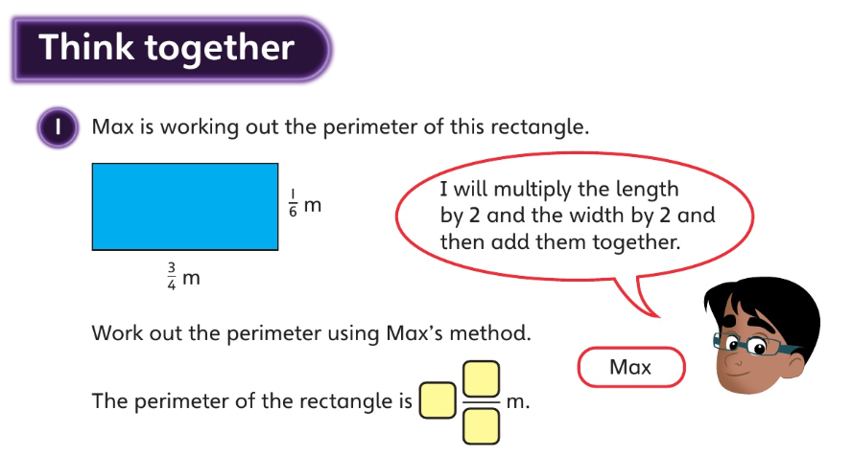

Slide 5
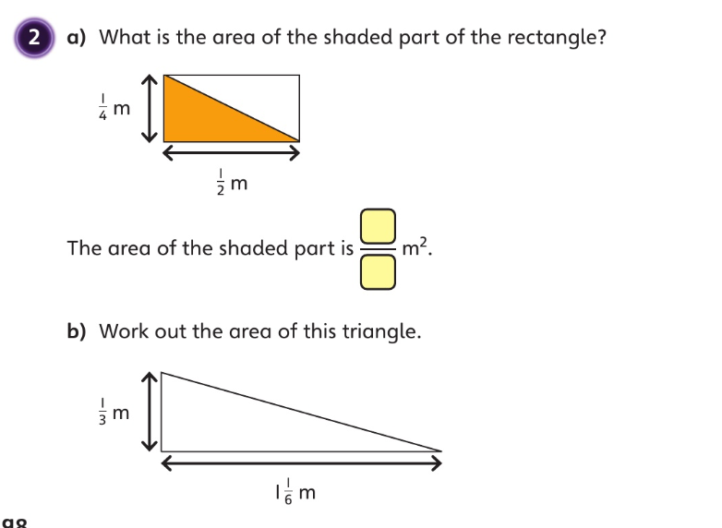

Slide 6
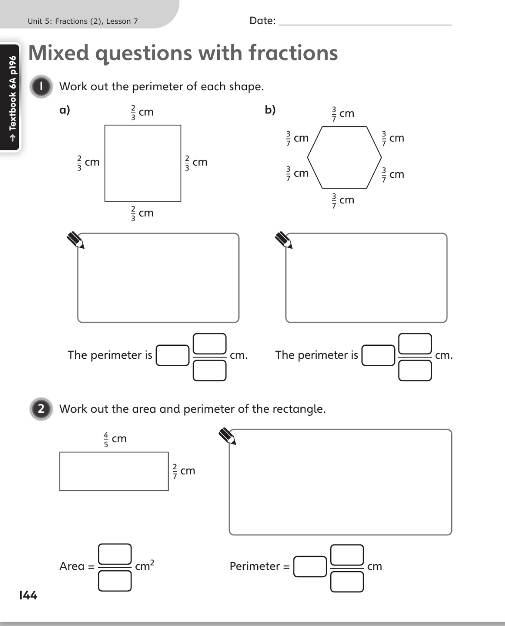

Power Maths
Pg 144 - 146

Slide 7
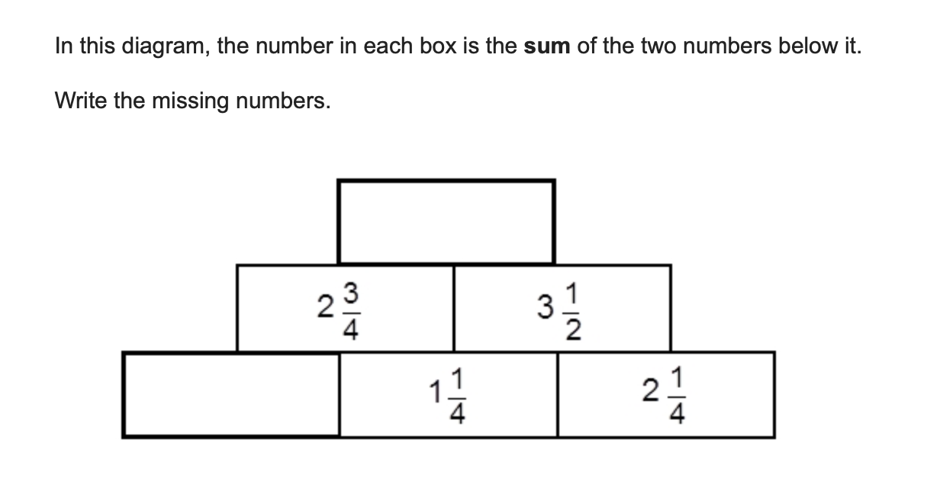
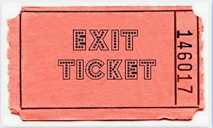

Slide 8
